Slide 1

adventure works 2022 sales DWH project
Optimizing sales operations and insights through data warehousing
Team Members:
Marina Mohsen . Aya Raafat . Salma Mustafa
Mahmoud Elsharnoby . Mohamed Hamdy .
Yousef Taha . Omar kamel . Yousef Sobhy

Slide 2
About AdventureWorks2022
• AdventureWorks2022 is a sample database provided by
Microsoft, widely used for learning and testing
purposes, especially in SQL Server environments. It
represents a fictional company called Adventure Works
Cycles, which manufactures and sells bicycles, parts,
and accessories.
• This database includes a wide variety of tables, views,
stored procedures, and functions that represent
different parts of the business such as sales,
purchasing, production, human resources, and more.

Slide 3
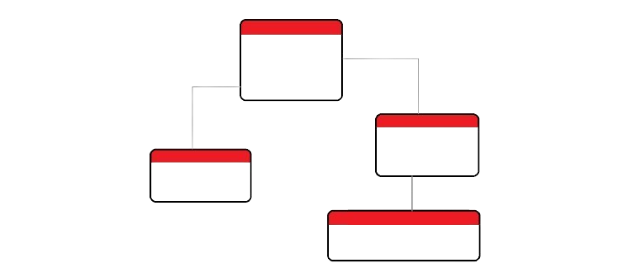
AdventureWorks2022 Schemas
The AdventureWorks2022 database organizes its tables and objects into multiple schemas. Schemas are used to logically group database objects, such as tables and views Below is an overview of the main schemas typically found in AdventureWorks2022:

Slide 4
1.DBO (Database Owner)
Contains general tables and objects that don’t fit into other specific schemas.
Tables include core data such as Error Log, Database Log, etc.
2.Person
Manages data related to people, including employees, customers, and contacts.
Key tables: Person, Address, Contact, Email Address, etc.

Slide 5
3. Production
Represents the manufacturing and product information for the Adventure Works Cycles company.
Key tables: Product, ProductModel, WorkOrder, BillOfMaterials, TransactionHistory, etc.
4. Sales
Focuses on sales data, including customer orders, invoices, and sales-related transactions.
Key tables: SalesOrderHeader, SalesOrderDetail, SalesTerritory, Customer, etc.

Slide 6
5. Purchasing
Contains data on vendor transactions, including purchase orders and product supplies.
Key tables: Vendor, PurchaseOrderHeader, PurchaseOrderDetail, etc.
6. HumanResources
Manages employee data such as department details, employee records, and job information.
Key tables: Employee, Department, Shift, JobCandidate, etc.

Slide 7
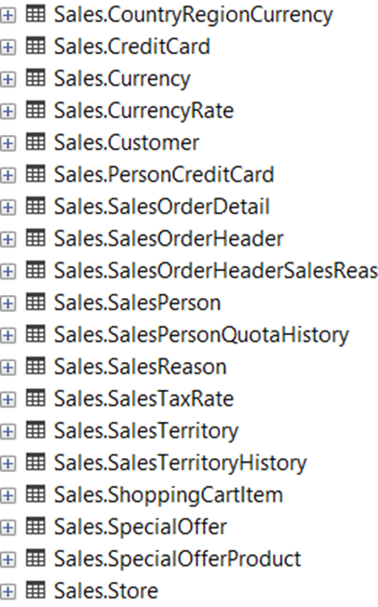
Business requirements :
Sales Schema
Best for sales-related business requirements.
If your business needs focus on managing customer orders, invoices, sales territories, or customer data.
Key tables:
SalesOrderHeader: Represents the sales order header information.
SalesOrderDetail: Stores details of each sales order line.
Customer: Holds customer information.
SalesTerritory: Tracks sales territories

Slide 8

Business Requirements for the Sales Schema
Objective:
The business requirements focus on utilizing the Sales schema within the AdventureWorks2022 database to optimize sales operations, customer management, and order processing. The goal is to enhance the efficiency and accuracy of the sales process while providing actionable insights through data analysis.

Slide 9
Key Business Requirements
1.Sales Order Management
Requirement: The system must accurately manage and store sales order information, including order creation, modification, and tracking.
Details:
Use the SalesOrderHeader and SalesOrderDetail tables to capture all relevant details of a customer’s order (e.g., order dates, shipping method, total amount).
Ensure proper linking between customer details in the Customer table and their respective orders.
Support for managing orders in various states (e.g., pending, fulfilled, cancelled).

Slide 10
2. Customer Data Management
Requirement: Store and update customer information.
Details:
The Customer table should store all customer-related information, including name, address, account number, and sales territory.
Ensure that customer records are unique, up-to-date, and linked to related orders and sales data.
Use SalesTerritory to organize customers by geographic regions for targeted sales strategies.

Slide 11
3. Sales Reporting and Analytics
Requirement: Enable the generation of sales reports for performance tracking and decision-making.
Details:
Leverage data from SalesOrderHeader, SalesOrderDetail, SalesTerritory, and Customer to generate insights into sales performance, top-selling products, and regional sales trends.
Support monthly, quarterly, and yearly reports for sales revenue, order volume, and customer retention.
Track and analyze sales performance by territory using the SalesTerritory table.

Slide 12
4. Sales Territory Management
Requirement: Efficiently manage and analyze sales territories (المناطق) to optimize sales operations.
Details:
The SalesTerritory table must be used to categorize customers and sales orders by geographic region.
Enable territory-based sales performance tracking, ensuring that each sales territory’s contribution is easily measurable.
Provide insights on regional demand and sales opportunities.

Slide 13
5. Sales Commission and Performance Tracking
Requirement: Track sales commissions for employees based on their sales performance.
Details:
Use the SalesPerson table to associate sales representatives with their sales orders.
Track the total value of sales generated by each sales representative and calculate commissions accordingly.
Ensure accurate recording of commission percentages based on performance, using the SalesPerson and SalesOrderHeader tables.

Slide 14
6. Product and Pricing Information
Requirement: Ensure accurate product and pricing details are associated with each sales order.
Details:
Link Product and SpecialOffer data with sales orders in SalesOrderDetail to ensure accurate product descriptions, quantities, and pricing.
Support for promotions or special offers and their impact on pricing in sales transactions.

Slide 15
7. Invoice Generation
Requirement: Generate invoices for customer orders.
Details:
Use SalesOrderHeader and SalesOrderDetail tables to generate detailed invoices, including product descriptions, quantities, and total amounts.
Ensure invoices reflect discounts, taxes, and shipping costs.
Provide invoice history for each customer order.

Slide 16
8. Returns and Refunds Management
Requirement: Handle product returns and refunds efficiently.
Details:
Maintain a process for tracking returned products, linking returns to the original sales orders using SalesOrderHeader and SalesOrderDetail.
Capture reasons for returns, and automate the process for issuing refunds or replacements.

Slide 17
9. Customer Satisfaction and Feedback
Requirement: Capture and analyze customer
feedback linked to sales orders.
Details:
Provide a method for storing customer feedback related to their purchases, linked to Customer and SalesOrderHeader.
Enable the analysis of feedback to assess customer satisfaction and improve future sales efforts.

Slide 18
SalesOrderHeader
Stores summary details of each sales order.
Manages and categorizes orders by region.
Key Tables
and
Relationships
SalesTerritory
SalesOrderDetail
Contains line-by-line details for products in each sales order.
Stores customer details and links to orders.
Customer
By implementing these business requirements, the Sales schema in AdventureWorks2022 can help streamline sales operations, improve data accuracy, and provide valuable insights for strategic decision-making

Slide 19
Conceptual Data Model
SalesOrder Fact (SalesOrderHeader, SalesOrderDetails)
Dimension (salesOrderHeader)
SaleTerritory Dimension (salesTerritory)
Customer Dimension (customer)
SalesPerson (salesPerson)
OrderDate Dimension:
SalesOrderID (primary key -> SalesOrder Fact)
OrderDate

Slide 20
SalesTerritory Dimension:
TerritoryID (primary key)
Name
CountryRegionCode
Customer Dimension:
CustomerID (primary key -> SalesOrderFact)
AccountNumber
TerritoryID (Foreign key -> SalesTerritory Dim)
SalesPerson:
BuisnessEntityID (primary key)
Bonus
CommissionPct
TerritoryID (Foreign key)

Slide 21
Physical Modeling

Slide 22
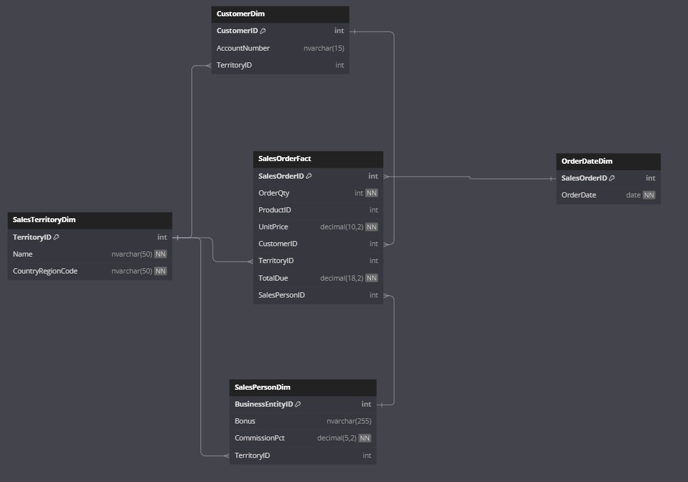

Slide 23
Power BI

Slide 24
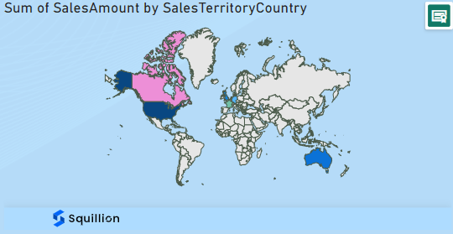

Slide 25
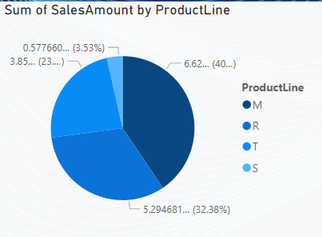

Slide 26
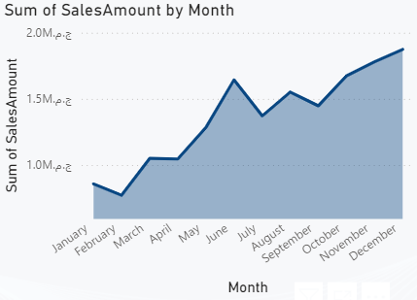


Slide 27
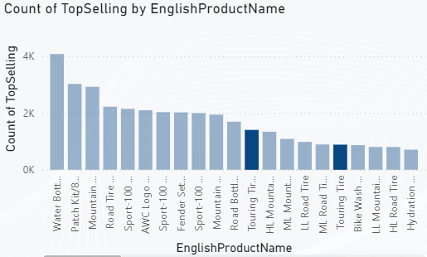

Slide 28
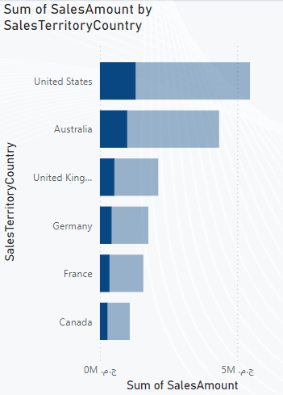
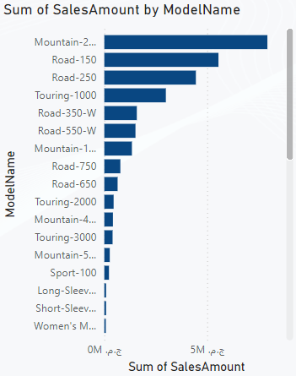

Slide 29
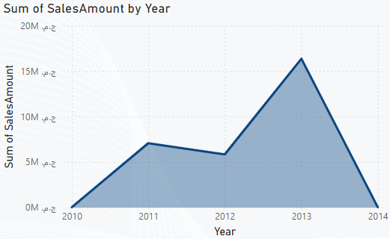

Slide 30
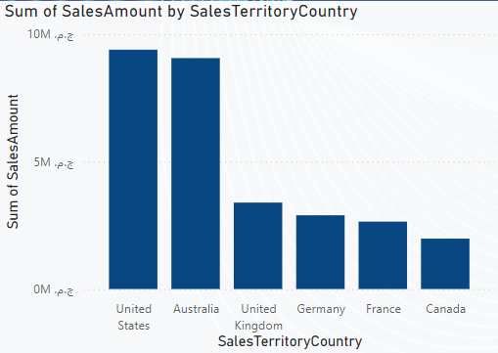

Slide 31


